Slide 1

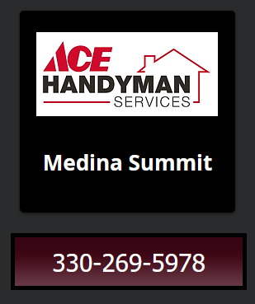

Search the
Builder’s New Homes
with the Search Cleveland Builders.com website…

Slide 2
sponsored by
Ace Handyman Services of Medina Summit.

Slide 3
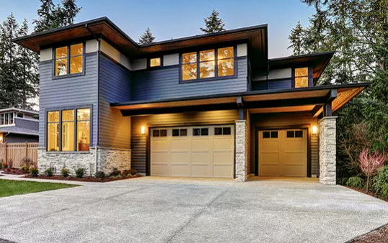
Have you ever considered buying a
New Home from a Builder?

Slide 4
The Search Cleveland Builders.com website
sponsored by
Ace Handyman Services of Medina Summit

Slide 5

was specifically designed to help
New Home Buyers
purchase more of the Builder’s New Homes.

Slide 6

It will connect you directly to the Builder’s
Community Maps New Home Floor Plans
Inventory Homes Online Sales Reps

Slide 7

You can use it to:
Perform
New Home Buyer Presentations…

Slide 8
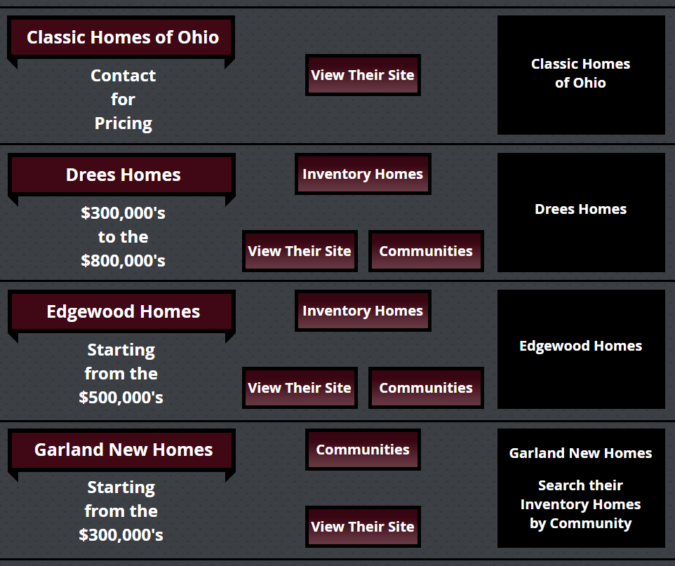
Sort through the
Maze of Builders…

Slide 9
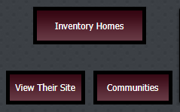
Connect directly to the Builder’s:
New Homes
Websites
Communities

Slide 10

Chat with the Builder’s online Sales Reps to:
Get help finding the right New Home
Get the latest Buyer Incentives
Register your Buyer online!

Slide 11
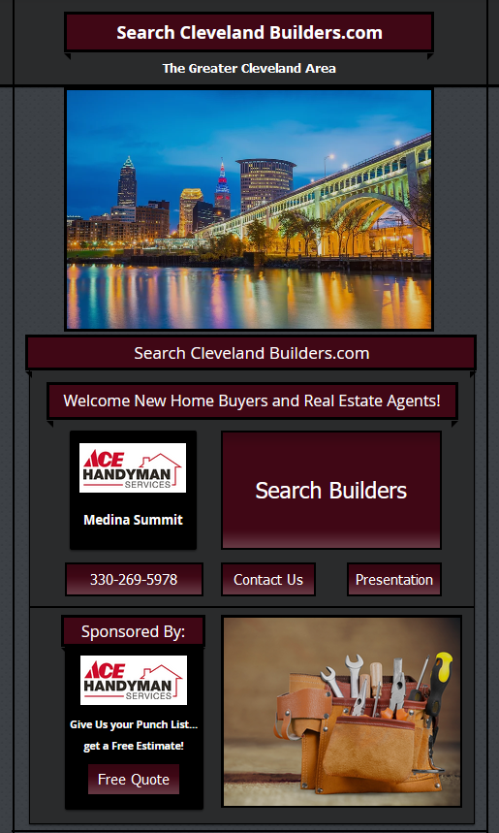
You can use the
Search Cleveland Builders.com
website...

Slide 12
sponsored by
Ace Handyman Services of Medina Summit...

Slide 13
to find a beautiful New Home from a Builder!

Slide 14
All we ask in return is that you refer us some Business.

Slide 15

A lot of New Home Buyers are going to need
Handyman Services.

Slide 16

We can provide you and New Home Buyers with:
Handyman Services

Slide 17

Give us your Punch List…
and get a Free Estimate!

Slide 18

Give us your Punch List…
and get a Free Estimate!

Slide 19

Give us your Punch List…
and get a Free Estimate!

Slide 20

Give us your Punch List…
and get a Free Estimate!

Slide 21
We can provide you with a Free Quote for your
Handyman Service needs!

